Slide 1

Netflix Data Analysis
INTERNSHIP PROJECT-3
(GROUP 2)
TEAM MEMBERS:
DHANANJAYA N
MANIKANTA DAMULURI
GITIKA
NAVEEN
ITISHREE

Slide 2
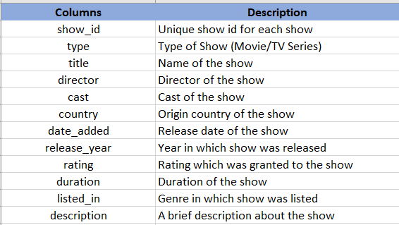
INTRODUCTION
Netflix is a leading streaming entertainment service that offers a variety of TV shows, movies, documentaries and reality shows
Python and Tableau have been used to make the analysis with the data provided

Slide 3
OBSERVATION
The dataset contains around 8807 unique titles from which around 6131 are movies and 2676 are TV shows
The popularity of Netflix depends on different genres of movies and TV shows available
There’s a rise in its demand from 2015 onwards with the increase in content around the globe

Slide 4
CONCLUSION
TV shows and movies are most popular in US followed by India and then UK
Foreign movies are mostly preferred
2019 marks the maximum Updation of content
Vatsal Dubey and Rajiv Chilaka have worked in around 15 movies and shows together

Slide 5
THANK YOU

